Slide 1

Project
on
Automotive Suspension System
Course code: EE650A
Basics of Modern Control Systems
Submitted by
Insha Rahman (241040612)
Arvind Trivedi (241040603)
Prakhar Bajpai (241040621)
G Karthik ( )
Submitted To,
Dr. Twinkle Tripathy
Assistant Professor
Department of Electrical Engineering
IIT Kanpur, India

Slide 2
Contents:
Introduction
Schematic diagram & Mathematical Model of Suspension System
State Space Representation
MATLAB Simulink model
Objective of Controller
Designing of State Feedback Controller
Justification for Performances of Controller
- Stability of closed loop system
- Controllability
Justification for Performances of Observer
Conclusion
References

Slide 3
Introduction
An Automotive Suspension system Allows the vehicle to absorb shocks and maintain contact with the road, even on rough surfaces.
Consist of springs, shock absorbers, and various linkages that help to manage the movement of the wheels relative to the body of the vehicle.
Springs absorb vertical energy from the wheels, when a vehicle goes over bumps, helping maintain a smooth ride.
Shock Absorbers (Dampers) control the motion of the springs, preventing excessive bounce and keeping the vehicle stable.

Slide 4
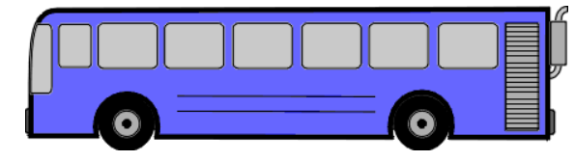
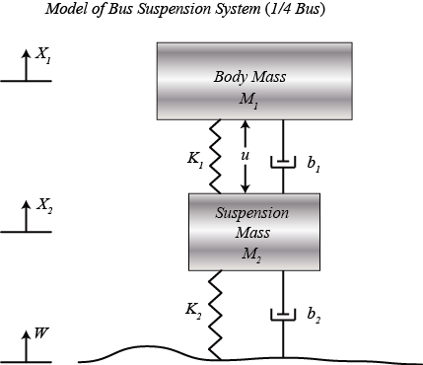

Automotive Suspension System
$M_{1} \frac{d^{2}X_{1}}{dt^{2}}$ = -b1($\frac{dX_{1}}{dt}$- $\frac{dX_{2}}{dt}$)-k1($X_{1}$-$X_{2}$)+U
$M_{2} \frac{d^{2}X_{2}}{dt^{2}}$ = b1($\frac{dX_{1}}{dt}$- $\frac{dX_{2}}{dt}$)+k1($X_{1}$-$X_{2}$)+b2($\frac{dW}{dt}$- $\frac{dX_{2}}{dt}$)+k2($W$-$X_{2}$)-U
Schematic diagram of an automotive suspension system

Slide 5


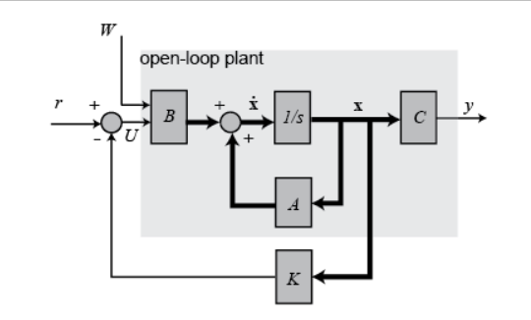
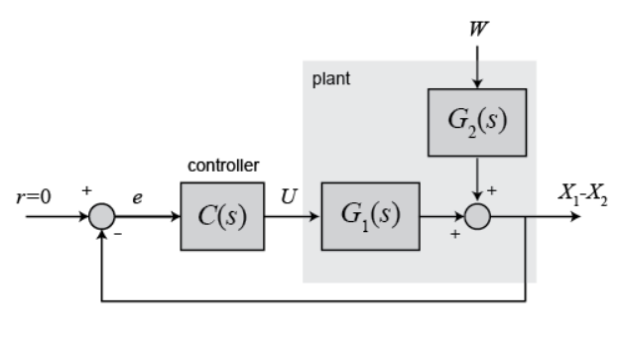


When W= 0
When U= 0
W
$G_{2}$(S)
r=0
$G_{1}$(S)
K

Slide 6
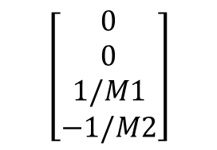
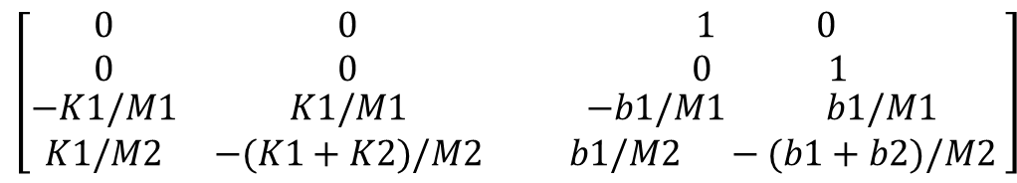
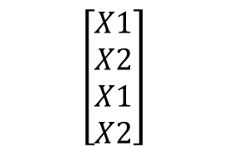


State Space Model
The state space representation of system:
X=AX+BU
Y=CX+DU
X
.
$$\left[\begin{aligned}X1 \\ X2 \\ X1 \\ X2\end{aligned}\right]$$
=
$$\left[\begin{matrix}0 & 0 & 1 0 \\ 0 & 0 & 0 1 \\ \begin{aligned}−K1/M1 \\ K1/M2\end{aligned} & \begin{aligned}K1/M1 \\ −(K1+K2)/M2\end{aligned} & \begin{aligned}−b1/M1 b1/M1 \\ b1/M2 −(b1+b2)/M2 \end{aligned}\end{matrix}\right]$$
=
A
$$\left[\begin{aligned}0 \\ 0 \\ 1/M1 \\ −1/M2\end{aligned}\right]$$
[C]=
[B]=
$$\left[1 −1 0 0\right]$$
[D]=
$$\left[ 0 \right]$$

Slide 7
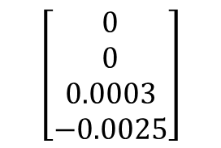
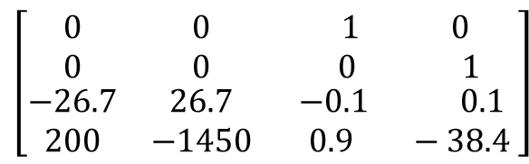


State Space Model
The state space representation of system:
X=AX+BU
Y=CX+DU
.
Vehicle ¼ mass: M1 = 3000 Kg;
Suspension mass: M2 = 400 Kg;
Spring constant: K1 = 80000 N/m;
Spring constant: K2 = 500000 N/m;
Damper constant: b1 = 350 N-S/m;
Damper constant b2 = 15020 N-S/m;
$$\left[\begin{matrix}0 & 0 & 1 0 \\ 0 & 0 & 0 1 \\ \begin{aligned}−26.7 \\ 200\end{aligned} & \begin{aligned}26.7 \\ −1450\end{aligned} & \begin{aligned}−0.1 0.1 \\ 0.9 −38.4 \end{aligned}\end{matrix}\right]$$
Matrix [A]=
$$\left[\begin{aligned}0 \\ 0 \\ 0.0003 \\ −0.0025\end{aligned}\right]$$
Matrix [B]=
Matrix [C]=
$$\left[1 −1 0 0\right]$$
Matrix [D]=
$$\left[ 0 \right]$$

Slide 8
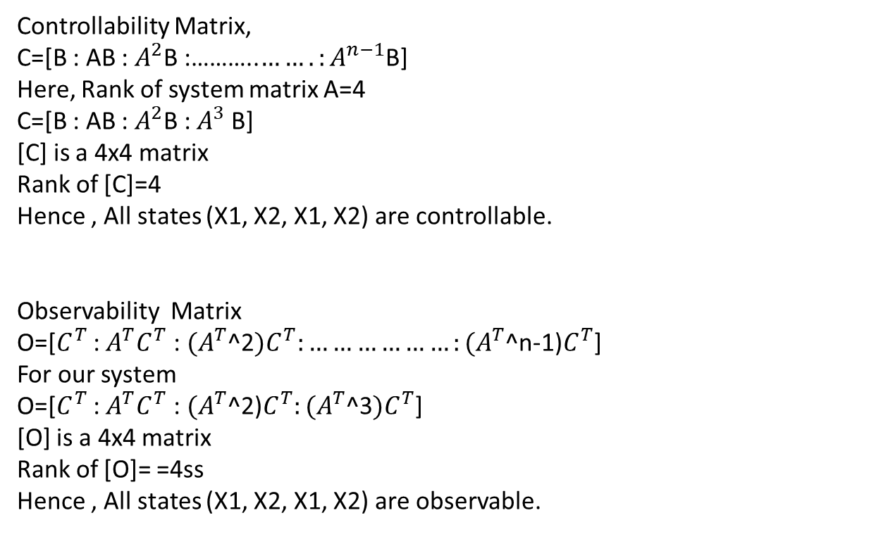
Controllability & Observability Tests
Controllability Matrix,
C=[B : AB : $A^{2}$B :………..${…….:A}^{n−1}$B]
Here, Rank of system matrix A=4
C=[B : AB : $A^{2}$B :$A^{3}$B]
[C] is a 4x4 matrix
Rank of [C]=4
Hence , All states (X1, X2, X1, X2) are controllable.
Observability Matrix
O=[$C^{T}$ : $A^{T}C^{T}$ : ${(A}^{T}$^2${)C}^{T}:………………{:(A}^{T}$^n-1)$C^{T}$]
For our system
O=[$C^{T}$ : $A^{T}C^{T}$ : ${(A}^{T}$^2)$C^{T}:{(A}^{T}$^3${)C}^{T}$]
[O] is a 4x4 matrix
Rank of [O]= =4ss
Hence , All states (X1, X2, X1, X2) are observable.

Slide 9
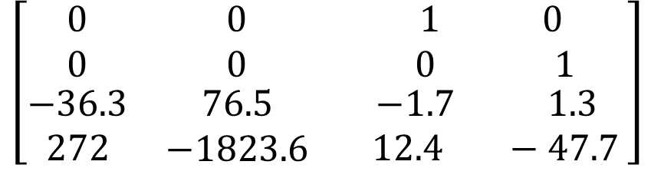
$$\left[\begin{matrix}0 & 0 & 1 0 \\ 0 & 0 & 0 1 \\ \begin{aligned}−36.3 \\ 272\end{aligned} & \begin{aligned}76.5 \\ −1823.6\end{aligned} & \begin{aligned}−1.7 1.3 \\ 12.4 −47.7 \end{aligned}\end{matrix}\right]$$
A’=

Slide 10
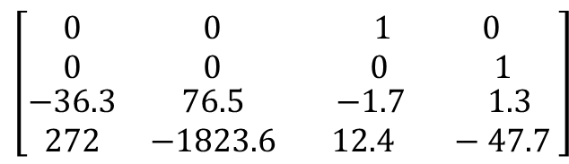
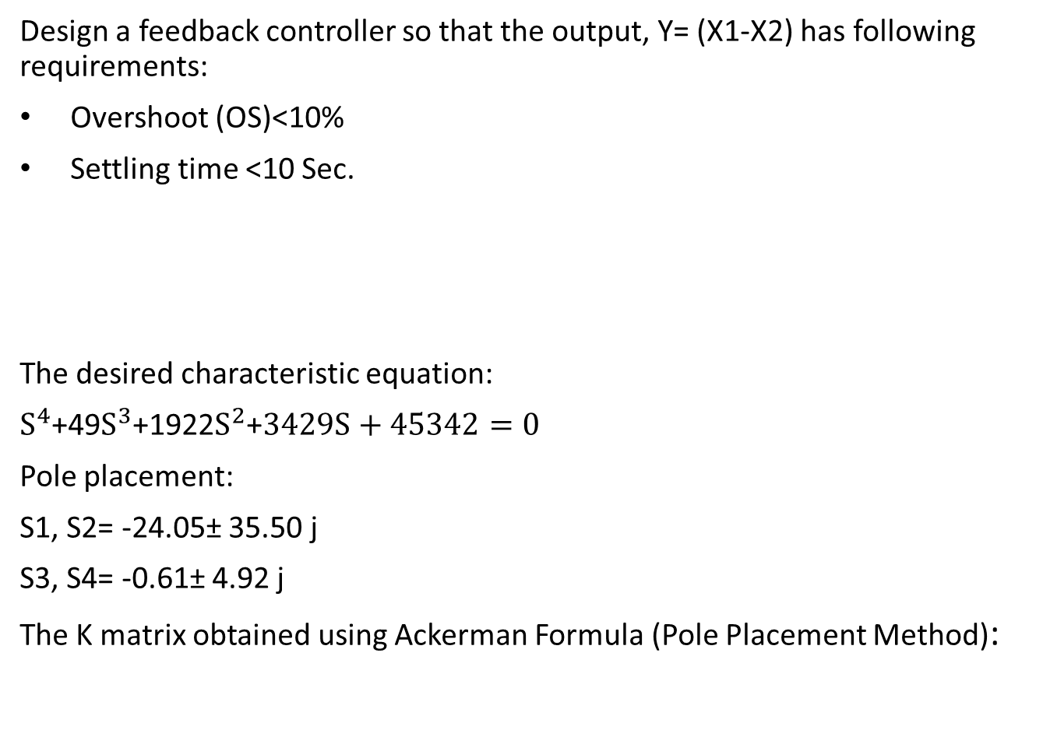

State Feedback Controller
Design a feedback controller so that the output, Y= (X1-X2) has following requirements:
Overshoot (OS)<10%
Settling time <10 Sec.
The desired characteristic equation:
$S^{4}$+49$S^{3}$+1922$S^{2}$+$3429S+45342=0$
Pole placement:
S1, S2= -24.05± 35.50 j
S3, S4= -0.61± 4.92 j
The K matrix obtained using Ackerman Formula (Pole Placement Method):
The state space representation of system:
x=Ax+Bu , U=-Kx
x=(A-Bk)x
.
$$\left[\begin{matrix}0 & 0 & 1 0 \\ 0 & 0 & 0 1 \\ \begin{aligned}−36.3 \\ 272\end{aligned} & \begin{aligned}76.5 \\ −1823.6\end{aligned} & \begin{aligned}−1.7 1.3 \\ 12.4 −47.7 \end{aligned}\end{matrix}\right]$$
Matrix [A-BK]=
.
K= $\left[28820 −14950 4610 −3700\right]$

Slide 11
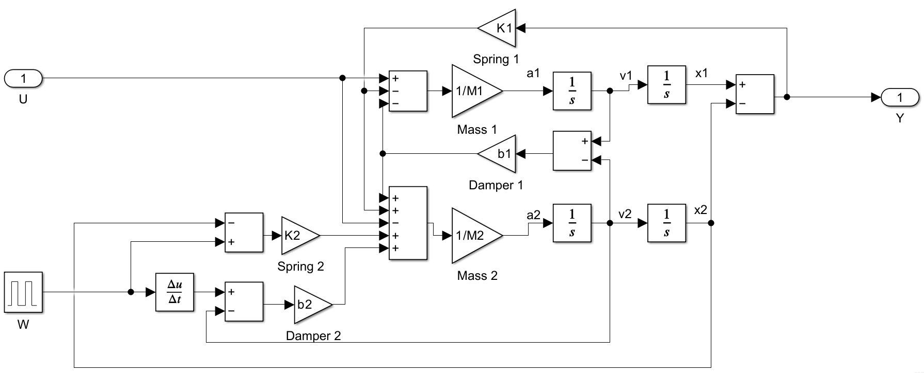
MATLAB Simulink Model of Plant
Suspension system model of Plant

Slide 12
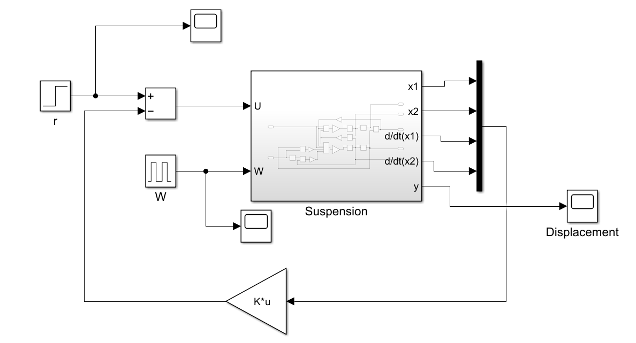
MATLAB Simulink Model of Closed Loop System
U: Control
Force
Reference input
Pothole
Output: Y=X1-X2
State Feedback Controller

Slide 13
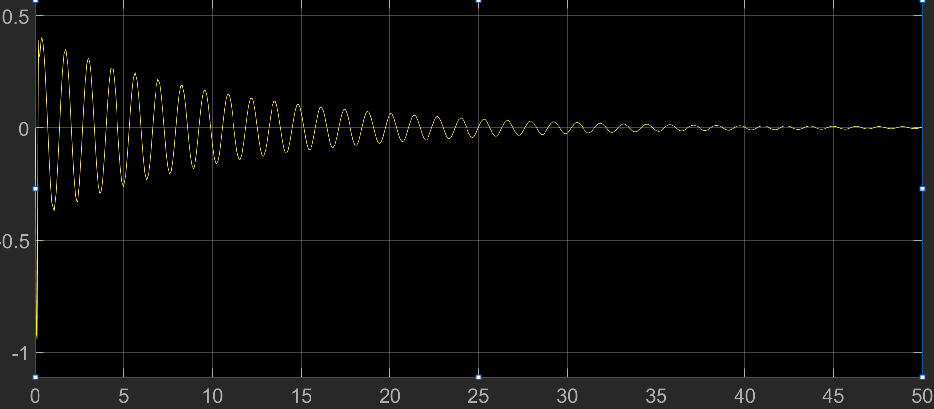
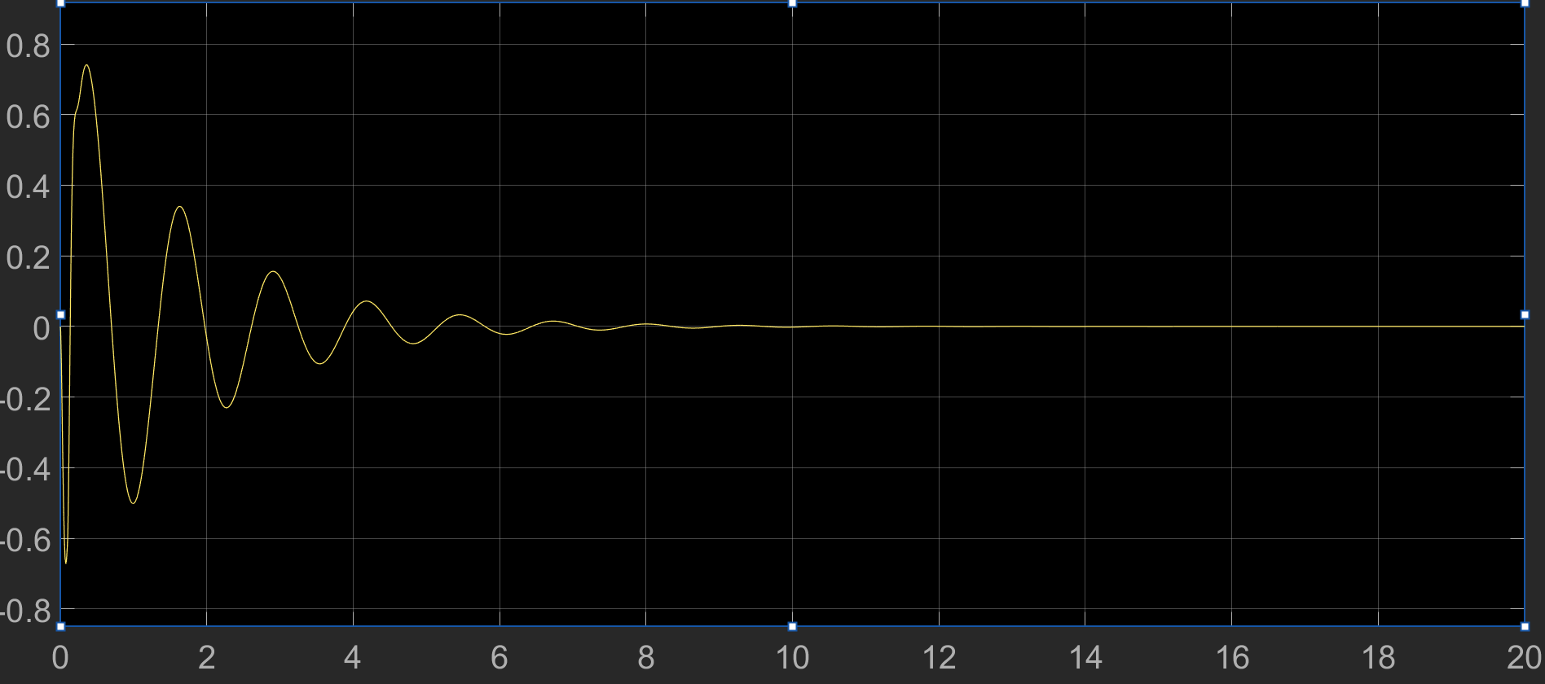
Simulation Results
Displacement (meter)
Displacement (meter)
Time(Sec)
Time(Sec)
Without State Feedback Controller
With State Feedback Controller
Assuming deep pothole, W=10 cm

Slide 14
Conclusions
Design of Automotive suspension system carried out in MATLAB Simulink environment.
State feedback controller is used to get desired response within specifications.
Design of state feedback controller, so that when the road disturbance (W) is simulated by a unit step input, the output Y=(X1-X2) has a settling time less than 10 seconds and an overshoot less than 10%.
When the bus runs onto a 10 cm high step, the bus body will oscillate within a range of +/- 5 mm and will stop oscillating within 10 seconds.
All states are found to be controllable & observable.
References:
Linear System Theory and Design by Chi-Tsong Chen.
https://ctms.engin.umich.edu/CTMS/?example=Suspension&section=Control State Space.

Slide 15
Thank you

Slide 16
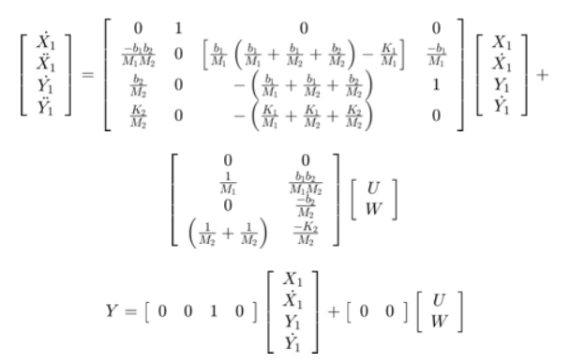
State Space Model of Automotive Suspension System

